Slide 1
VAGINA
BY
F.O.OPOOLA

Slide 2
INTRODUCTION
The vagina is an organ of the female reproductive tract. It is a distensible fibromuscular tube which extends posterosuperiorly from the external vaginal orifice to the cervix.
The cervix protrudes into its proximal end, which is enlarged and forms the vaginal fornix (vaginal vault). The vagina opens into the vaginal vestibule of the vulva (vaginal opening) at its distal end.

Slide 3
INTRODUCTION
The vagina tilts posteriorly between the urethra and rectum, with the urethra bound to its anterior wall.
If standing, the vaginal tube will point in a superoposterior direction to form a 45 degree angle with the uterus and an about 60 degree angle to the horizontal.
The exact angle is variable depending on individual anatomy and with contents of the bladder and colon.
Due to this tilting, the posterior wall of the vagina (8 to 10 centimeters (3 to 4 inches)) is longer than its anterior wall (7.5 centimeters (2.5 to 3 inches)).

Slide 4
INTRO.. CONT’D
Fig 1 – Overview of the female reproductive tract.

Slide 5
FUNCTION
It has several roles within the female reproductive system:
Sexual intercourse – receives the penis and ejaculate, assisting in its transport to the uterus.
Childbirth – expands to provide a channel for delivery of a newborn from the uterus.
Menstruation – serves as a canal for menstrual fluid and tissue to leavethebody

Slide 6
ANATOMICAL STRUCTURE
Upper two thirds of vagina
Anatomically, the base of the bladder and the urethra is related to the anterior wall of the vagina, while, posteriorly, the vagina is related to the rectum.
Internally, the cervix protrudes into the proximal end of the vagina forming an enlarged recess between its lower margin and the vaginal wall.
This blind-ended space is called vaginal fornix. There is a large posterior part of vaginal fornix, a smaller anterior part in addition to two small lateral parts.

Slide 7
ANATOMICAL STRUCTURE
Lower third of vagina
At the lower end of the vagina (lower third) are vaginal rugae, which allow for expansion of the luminal surface of the vaginal wall during childbirth.
While the vagina itself does not have glands, it is lubricated by mucus from the cervical glands found above it, a process which is hormonally controlled.
Upon sexual arousal, vaginal secretions can also come from the uterus, or a minuscule amount from the greater vestibular glands (of Bartholin).
Engorgement of vaginal blood vessels during arousal also results in increased blood flow/pressure which causes fluid, known as vaginal transudate, to be pushed from the vasculature of the lamina propria onto the vaginal surface through transudation (i.e. escape of liquids via pores or breaks in the cell membranes).

Slide 8
ANATOMICAL STRUCTURE
Vaginal opening
Anatomically, the vagina is the fibromuscular canal between the hymen and cervix.
The vulva includes all of the external genital organs seen outside of the body, which include:
the mons pubis (Latin for “pubic mound”)
labia majora (outer lips)
labia minora (inner lips)
clitoris
the external openings of the urethra and vagina.

Slide 9
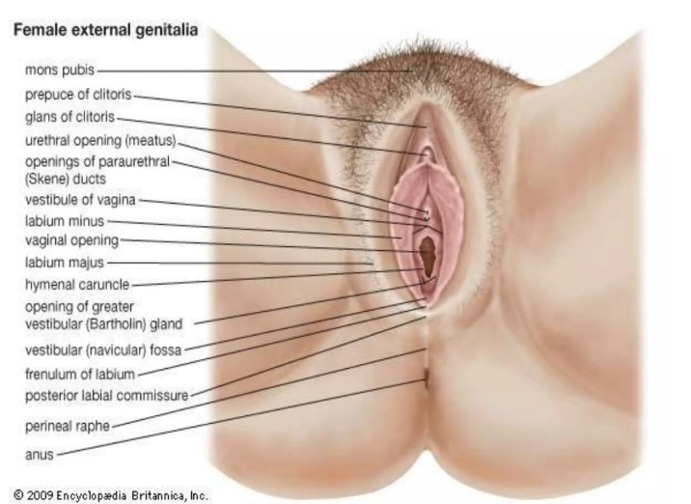

Slide 10
ANATOMICAL STRUCTURE
Hymen
At the vulva, the vaginal orifice (the introitus) may be partially covered by a membrane formed by inward folding mucosa known as the hymen. This is a thin mucosal structure found posterior to the urethra that partially or completely covers the entrance to the vagina.
It is surrounded by the vaginal vestibule, which is exposed with spreading of the labia. The hymen stretches across the vaginal lumen and is normally incomplete to allow for passage of menstrual flow. It can be perforated during sexual intercourse, insertion of menstrual products, such as tampons, or during childbirth.
Hymenal caruncles are small firm reddish nodules located around the vaginal orifice in adult women; they are remnants of the hymen. The hymen is often crescent-shaped in preadolescent females, but many shapes are possible.

Slide 11
BOUNDARIES
The vagina is closely related to many of the organs in the pelvic region:
Anterior – bladder and urethra.
Posterior – rectouterine pouch, rectum and anal canal.
Lateral – ureters and levator ani muscle.
Fig 2: Saggital section of the female pelvis showing the anatomical relation of the Vagina

Slide 12
ANATOMICAL STRUCTURE
The vagina is a fibromuscular tube with anterior and posterior walls – these are normally collapsed and thus in contact with one another.
The shape of the vagina is not a round tunnel. In the transverse plane it is more like an “H” lying on the side. At the upper ending, the vagina surrounds the cervix, creating two domes (fornices or vaults): an anterior and a (deeper) posterior one.
The posterior fornix is important as it acts like a natural reservoir for semen after intravaginal ejaculation. The semen retained in the fornix liquefies in the next 20-30 mins, allowing for easier permeation through the cervical canal.

Slide 13
Fig 3 – The anterior and posterior vaginal fornices

Slide 14
HISTOLOGY OF THE VAGINA
The vagina is composed of four histological layers (internal to external):
Stratified squamous epithelium – this layer provides protection and is lubricated by cervical mucus (the vagina itself does not contain any glands).
Elastic lamina propria – a dense connective tissue layer which projects papillae into the overlying epithelium. The larger veins are located here.
Fibromuscular layer – comprising two layers of smooth muscle; an inner circular and an outer longitudinal layer.
Adventitia – a fibrous layer, which provides additional strength to the vagina whilst also binding it to surrounding structures.

Slide 15
Vascular Supply and Lymphatics
The arterial supply to the vagina is via the uterine and vaginal arteries – both branches of the internal iliac artery.
Venous return is by the vaginal venous plexus, which drains into the internal iliac veins via the uterine vein.
Lymphatic drainage is divided into three sections:
Superior – drains to external iliac nodes
Middle – drains to internal iliac nodes
Inferior – drains to superficial inguinal lymph nodes.
By TeachMeSe
Fig4:posterior view of the arterial supply to the female reproductive tract

Slide 16
Innervation
Innervation is predominantly from the autonomic nervous system. Parasympathetic and sympathetic nerves arise from the uterovaginal nerve plexus (in turn a subsidiary of the inferior hypogastric plexus).
Only the inferior 1/5 of the vagina receives somatic innervation. This is via a branch of the pudendal nerve, the deep perineal nerve.
There is a higher concentration of nerve endings near the entrance of the vagina (lower third) that provides sexual pleasure when stimulated, and women may also derive pleasure from a feeling of closeness and fullness during sexual intercourse.
Uterovaginal plexus
Plexus uterovaginalis

Slide 17
Autonomic efferent innervation to the upper two thirds of the vagina is supplied through the uterovaginal plexus containing both sympathetic and parasympathetic fibers.
Sympathetic efferent fibers from the lumbar splanchnic nerves (lumbar outflow) travel first through the superior hypogastric plexus, and then through the bilateral hypogastric nerves to reach the inferior hypogastric plexuses, and finally the uterovaginal plexus.
Parasympathetic efferent fibers to the uterovaginal plexus originate from the pelvic splanchnic nerves (S2-S4) (sacral outflow).
Autonomic efferent innervation to the lower third of the vagina is carried through the pelvic splanchnic nerves (S2-S4).
General visceral afferent (GVA) fibers from the upper vagina travel through the pelvic splanchnic nerves to the sacral plexus. Afferent fibers from the lower vagina are carried by the pudendal nerve

Slide 18
Somatic sensation exists primarily in the distal one third of the vagina and is also carried by general somatic afferent fibers within the pudendal nerve to the sacral plexus.
Despite the scientific examinations of vaginal wall innervation showing no consistent or single areas with greater nerve ending densities, some women do have a greater density of nerve endings in the anterior vaginal wall that can lead to heightened sensitivity and pleasure when the anterior wall is stimulated.
Therefore, it is in the anterior wall that the vaginal erogenous zone is located (commonly referred to as the ‘G-spot’ or Gräfenberg spot).
In these examples, the outer third of the vagina near the opening will have more nerve endings, making it more sensitive to touch than the deeper and inner two-thirds of the vagina. Functionally, this is most likely the case so that childbirth will be significantly less painful, since increased nerve endings throughout would otherwise equate to more pain.

Slide 19
Clinical Anatomy
Vaginal (Obstetric) Fistulae
A vaginal fistula is an open communication between the vagina and one of the adjacent pelvic organs.
It typically occurs as a result of prolonged labour (where a Caesarean section is not available). As the fetus slowly progresses down the vaginal wall, it exerts pressure – obstructing the blood supply and causing tissue necrosis.
There are three main types of vaginal fistulae:
Vesicovaginal – abnormal communication with the bladder. Urine enters the vagina.
Urethrovaginal – abnormal communication with the urethra. Urine only enters the vagina during urination.
Rectovaginal – abnormal communication with the rectum. Faecal matter can enter the vagina.

Slide 20
Common infections and diseases that can affect the vagina include candidal vulvovaginitis, vaginitis, vaginismus, sexually transmitted infections (STIs) or cancer.
Vaginitis
Vaginitis is an inflammation of the vagina, and is attributed to several vaginal diseases.
Sexually transmitted infections
Sexually transmitted infections (STIs) or sexually transmitted diseases (STDs) are often caused by:
HIV/AIDS
human papillomavirus (HPV)
genital herpes
Trichomoniasis
.

Slide 21
It is therefore recommended by health care providers to appreciate safe sex practices (male or female condoms), while engaging in sexual activity to prevent transmittance of these STIs and STDs.
Cervicovaginal (PAP) smear
For women of childbearing age, it is recommended to receive cervical screens (Pap smear tests and HPV vaccines). Cervical cancer can be prevented if caught early enough through cervical screening or prophylactically by HPV vaccines.
It is recommended for women to begin Pap smear tests starting around 21 years old until 65 years of age, with frequency varying from 3 to 5 years depending on age, genetics, or environmental factors.
Vaginal cancer is a very rare condition that is related more to old age, and its symptoms include abnormal vaginal bleeding or vaginal discharge

Slide 22
SUMMARY
Definition | A copulatory organ of the female reproductive system
Parts | Vaginal fornix (anterior/posterior/lateral parts), anterior and posterior walls of vagina, hymen, vaginal wall layers (mucosa [vaginal rugae → vaginal columns], lamina propria, muscular layer, adventitial layer)
Blood supply | Vaginal and uterine arteries (branches of internal iliac artery)
Innervation | Upper two thirds of vagina: - Sympathetic efferent fibers from lumbar splanchnic nerves via uterovaginal plexus - Parasympathetic efferent fibers from pelvic splanchnic nerves via uterovaginal plexus - General visceral afferent (GVA) fibers carried via pelvic splanchnic nerves (S2-S4) Lower third of vagina: - Parasympathetic efferent fibers from pelvic splanchnic nerves (S2-S4) - General somatic afferent (GSA) fibers carried via pudendal nerve (S2-S4)
Function | Acts as a birth canal, the outlet for the menstrual blood flow and a cavity for sexual intercourse.

